Slide 1



Eχαμs: A Multi-Subject High School Examinations Dataset for Cross-Lingual and Multilingual Question Answering
Momchil Hardalov¹, Todor Mihaylov², Dimitrina Zlatkova¹, Yoan Dinkov¹,
Ivan Koychev¹, and Preslav Nakov³ ¹Sofia University ²Heidelberg University ³Qatar Computing Research Institute, HBKU
The 2020 Conference on Empirical Methods in Natural Language Processing (EMNLP 2020)

Slide 2
What is a Matriculation (Exit) Exam?
Definition: “An exam (test) that students must pass to receive a diploma (leaving certificate) and graduate from school, can be a university entrance examination.”
Taken by students graduating from high school
Often requires knowledge learned through the entire course
Students take exams for several school subjects
https://en.wikipedia.org/wiki/Matriculation_examination
https://en.wikipedia.org/wiki/Exit_examination

Slide 3
Examples
Original
English
Si quitamos un electrón de un átomo de oxígeno, ¿qué obtenemos?
A) Un isótopo.
B) Un núcleo desnudo.
C) Un ion.
D) Un átomo excitado.
If we remove an electron from an oxygen atom, what do we get?
A) An isotope.
B) A bare nucleus.
C) An ion.
D) An excited atom.
Physics
Milyen számlák egyenlege jelenik meg a Mérlegben?
A) Eredmény, forrás.
B) Eszköz, forrás, eredmény.
C) Eszköz, eredmény.
D) Eszköz, forrás.
Which account balances appear in the Balance Sheet?
A) Result, source.
B) Asset, source, result.
C) Asset, result.
D) Asset, source.
Economics
Notes:
For the first question: https://www.quora.com/What-would-happen-if-you-removed-an-electron-or-a-proton-out-of-an-atom
The act of removing electrons from an atom is called oxidation. When an atom oxidises, it terns into an cation (a cation is a positively charged ion). The atom decreases in radius because there is less shielding effect among the existing electrons. For the second

Slide 4
Eχαμs: Our Dataset
24,143 multiple-choice questions from high school examinations
Parmi les vitesses ci-dessous choisissez la vitesse minimale.
A) 1 m/s.
B) 0,0036 km/s.
C) 7,2 km/h.

Slide 5
Eχαμs: Our Dataset
24,143 multiple-choice questions from high school examinations
Natural Sciences
Social Sciences
Others
24
Subjects
Geography
History
Professional
Forestry
Biology
Geology
Landscaping
Psychology
Politics
Social
Religion
Chemistry
Citizenship
Philosophy
Informatics
Fine Arts
Physics
Science
Business & Economics
Tourism
Agriculture
Sociology
Ethics
Islamic Studies
etc.
Parmi les vitesses ci-dessous choisissez la vitesse minimale.
A) 1 m/s.
B) 0,0036 km/s.
C) 7,2 km/h.

Slide 6
Eχαμs: Our Dataset
24,143 multiple-choice questions from high school examinations
Natural Sciences
Social Sciences
Others
24
Subjects
Geography
History
Professional
Forestry
Biology
Geology
Landscaping
Psychology
Politics
Social
Religion
Chemistry
Citizenship
Philosophy
Informatics
Fine Arts
Physics
Science
Business & Economics
Tourism
Agriculture
Sociology
Ethics
Islamic Studies
etc.
Parmi les vitesses ci-dessous choisissez la vitesse minimale.
A) 1 m/s.
B) 0,0036 km/s.
C) 7,2 km/h.
ar
bg
de
es
fr
hr
hu
it
16
Languages
8
Families
lt
mk
pl
pt
sq
sr
tr
vi

Slide 7
Eχαμs: Our Dataset
24,143 multiple-choice questions from high school examinations
Natural Sciences
Social Sciences
Others
24
Subjects
Geography
History
Professional
Forestry
Biology
Geology
Landscaping
Psychology
Politics
Social
Religion
Chemistry
Citizenship
Philosophy
Informatics
Fine Arts
Physics
Science
Business & Economics
Tourism
Agriculture
Sociology
Ethics
Islamic Studies
etc.
9,857
Parallel Questions
Parmi les vitesses ci-dessous choisissez la vitesse minimale.
A) 1 m/s.
B) 0,0036 km/s.
C) 7,2 km/h.
Welche ist die kleinste von den folgenden Geschwindigkeiten?
A) 1 m/s.
B) 0,0036 km/s.
C) 7,2 km/h.
ar
bg
de
es
fr
hr
hu
it
16
Languages
8
Families
lt
mk
pl
pt
sq
sr
tr
vi

Slide 8
QA Tasks and Datasets
Science QA
Eχαμs
Multilignual QA
Regents (Clark et al., 2019)
Covers various domains
3x larger than Science QA datasets (ARC)
Extends multilingual QA tasks to more languages
The questions are written by experts
Questions from matriculation exams rather than 4-8th grade
TyDi (Clark et al., 2020)
ARC (Clark et al., 2018)
MKQA (Longpre et al., 2020)
SciQA (Welbl et al., 2017)
XQuAD (Artetxe et al., 2020)
OpenBookQA (Mihaylov et al., 2018)
MLQA (Lewis et al., 2020)
LifeCycleQA (Mitra et al., 2018)
KorQuAD (Lim et al.,2019)
RACE (Lai et al., 2017)
FQuAD (d’Hoffschmidt et al., 2020)
QuaRel (Tajford et al., 2018)
SberQuAD (Efimov et al., 2020)

Slide 9
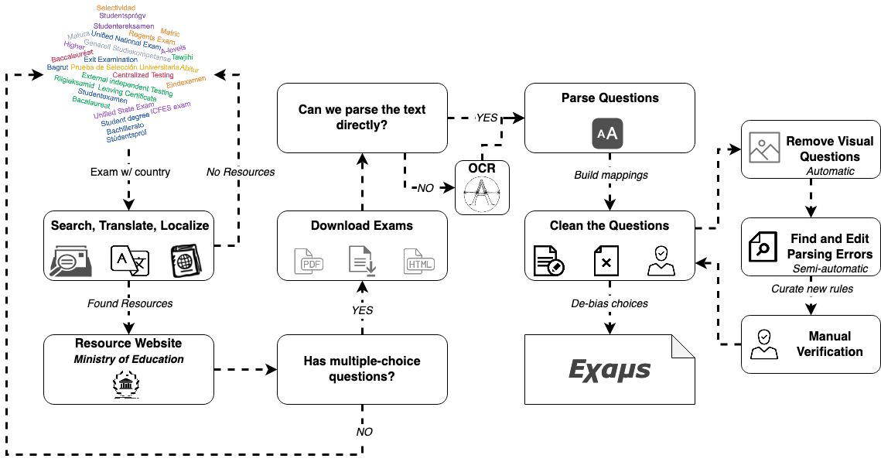
Dataset Creation
Notes:
The world cloud is created with https://www.wordclouds.com/

Slide 10
Dataset Creation
Notes:
The world cloud is created with https://www.wordclouds.com/

Slide 11
Dataset Creation
Notes:
The world cloud is created with https://www.wordclouds.com/

Slide 12
Dataset Creation
Notes:
The world cloud is created with https://www.wordclouds.com/

Slide 13
Dataset Creation
Notes:
The world cloud is created with https://www.wordclouds.com/

Slide 14
Dataset Creation
Notes:
The world cloud is created with https://www.wordclouds.com/

Slide 15
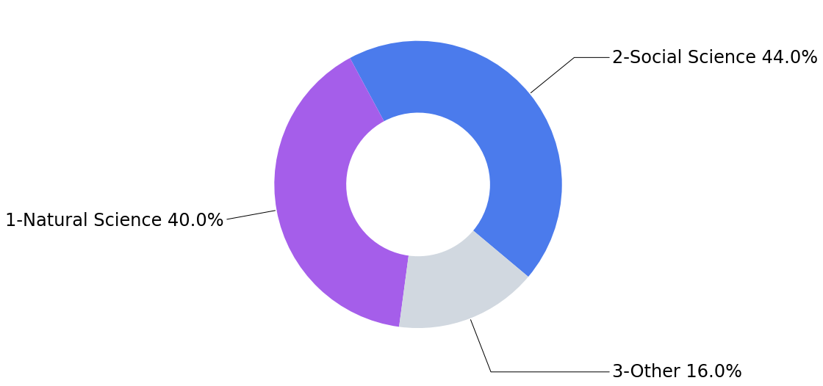
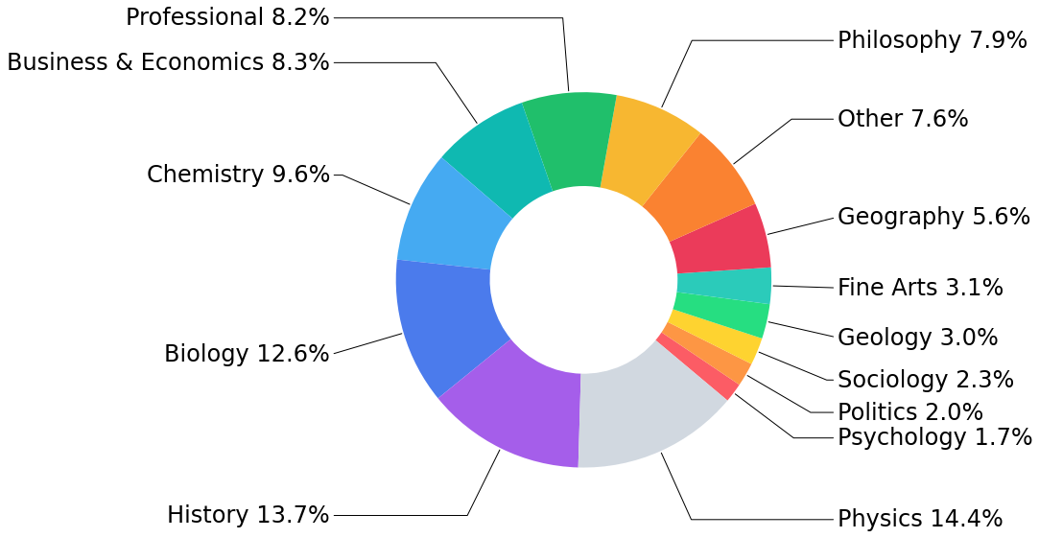
Subjects and Categories
Natural Science “the study of natural phenomena”*
Biology, Chemistry, Geology, Physics, Science
Social Science “the study of human behavior and societies”*
Business & Economics, Citizenship, Ethics, Geography, History, Philosophy, Politics, Psychology, Social, Sociology
Other Applied Studies, Arts, Religion, etc.
Agriculture, Fine Arts, Forestry, Informatics, Islamic Studies, Landscaping, Professional, Religion, Tourism
*Definitions are taken from https://en.wikipedia.org/wiki/Branches of science

Slide 16
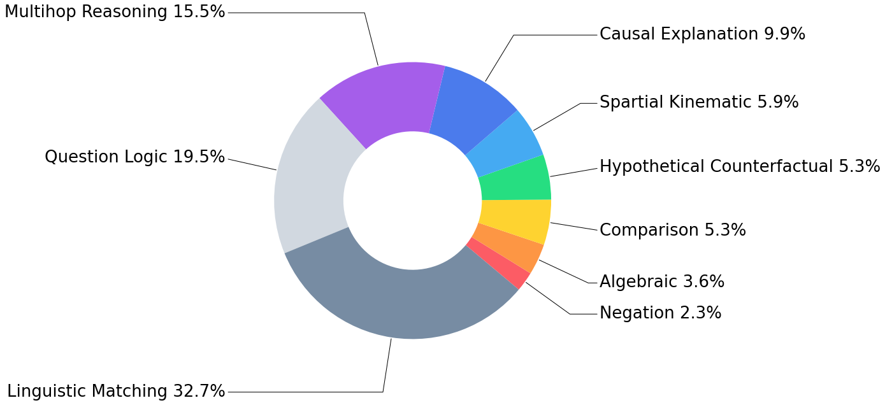
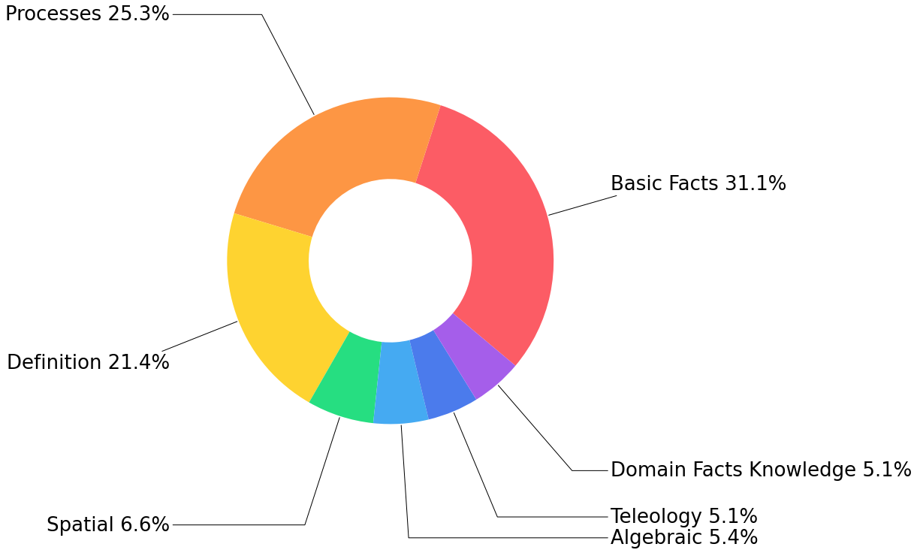
Required Reasoning and Knowledge Types
Reasoning
Knowledge
*We followed the procedure and re-used the annotation types presented in (Clark et al., 2018; Boratko et al., 2018)

Slide 17
Baselines
No Training
Information Retrieval*
Fine-Tuning with External Knowledge*
Multilingual BERT
XLM-RoBERTa
Without External Knowledge
XLM-R without context
Pre-trained Model as a Knowledge Base (Question + [MASK_option])
*All the baselines that require context, query an inverted index built on top of the language specific Wikipedias’ dumps.

Slide 18
Evaluation
Goal: Explore the multilingual and the cross-lingual question answering capabilities of different models.
Multilingual (Multi-language transfer)
Train 37.5%, Dev 12.5%, Test* 50%
Cross-lingual (Transfer from Lang_{Source} to Lang_{Target})
Source: Train 80%, Dev 20%, Target: Multilingual Test*
Caveats:
*For languages with less than 900 questions we only have Test
There are no parallel questions in different subsets

Slide 19
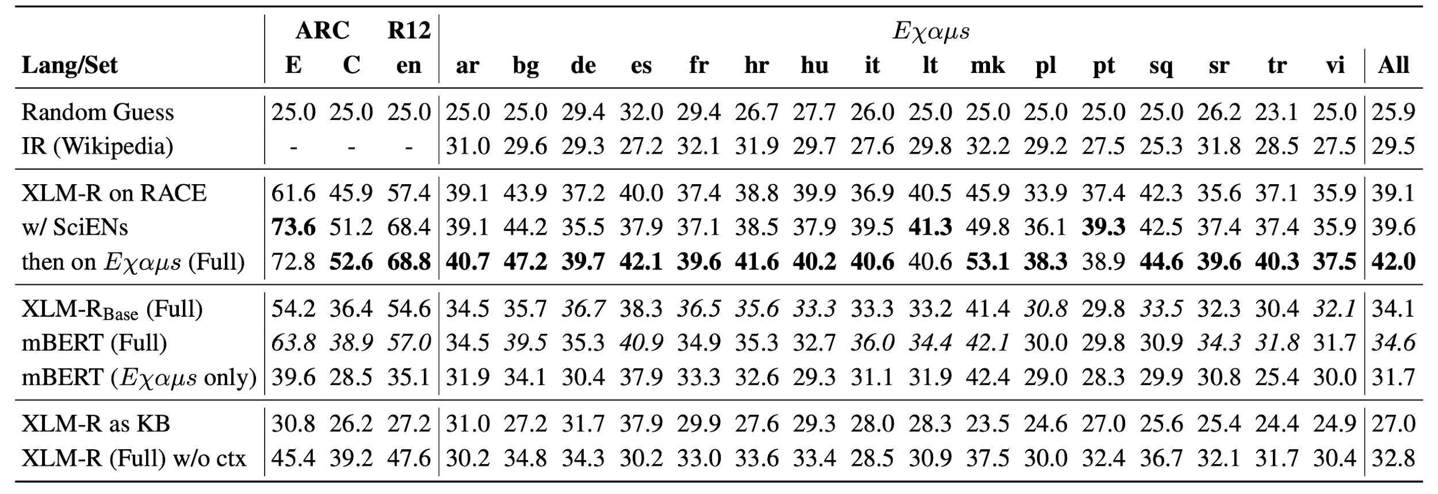
Multilingual Evaluation
How multiple languages benefit when combined together?
Standard Baselines
With External Knowledge
No External Knowledge
*All the baselines that require context, query an inverted index built on top of the language specific Wikipedias’ dumps.

Slide 20
Multilingual Evaluation
IR does not work well alone
Standard Baselines
3.6%
With External Knowledge
No External Knowledge
*All the baselines that require context, query an inverted index built on top of the language specific Wikipedias’ dumps.

Slide 21
Multilingual Evaluation
Fine-tuning on QA (in-domain) data from multiple languages has a large impact.
Standard Baselines
-0.8-+1.4%
0.5%
With External Knowledge
2.4%
No External Knowledge
*All the baselines that require context, query an inverted index built on top of the language specific Wikipedias’ dumps.

Slide 22
Multilingual Evaluation
XLM-R_{Base} and mBERT have close performance on Eχαμs
Standard Baselines
With External Knowledge
No External Knowledge
*All the baselines that require context, query an inverted index built on top of the language specific Wikipedias’ dumps.

Slide 23
Multilingual Evaluation
Training on more data in a single language helps.
Standard Baselines
With External Knowledge
9% relative improvement
No External Knowledge
*All the baselines that require context, query an inverted index built on top of the language specific Wikipedias’ dumps.

Slide 24
Multilingual Evaluation
The questions are hard, the knowledge in the LM is not enough .*
Standard Baselines
With External Knowledge
1%
9%
No External Knowledge
*One might get better results, if the questions are re-written as sentences.

Slide 25
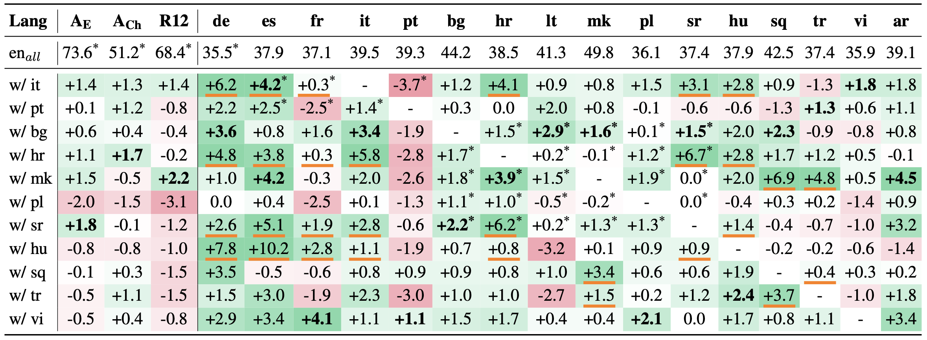
Cross-lingual Evaluation
Which language pairs work well?
The underlined values mark languages that have parallel data with the source language, and the ones with an asterisk* are from the same family.
Results in bold are the highest for the language (when fine-tuned on languages without parallel data).

Slide 26
Cross-lingual Evaluation
Questions from the same language family help
The underlined values mark languages that have parallel data with the source language, and the ones with an asterisk* are from the same family.
Results in bold are the highest for the language (when fine-tuned on languages without parallel data).

Slide 27
Cross-lingual Evaluation
Language family does not help as much
if the subjects are niche
The underlined values mark languages that have parallel data with the source language, and the ones with an asterisk* are from the same family.
Results in bold are the highest for the language (when fine-tuned on languages without parallel data).
Notes:
Niche subjects: Professional, Philosophy, Economics, Geology

Slide 28
Cross-lingual Evaluation
Largely represented and harder subjects help! Biology, History, Chemistry, Physics, and Geography
The underlined values mark languages that have parallel data with the source language, and the ones with an asterisk* are from the same family.
Results in bold are the highest for the language (when fine-tuned on languages without parallel data).

Slide 29
Cross-lingual Evaluation
The model learns the questions even if seen in another language.
The underlined values mark languages that have parallel data with the source language, and the ones with an asterisk* are from the same family.
Results in bold are the highest for the language (when fine-tuned on languages without parallel data).

Slide 30
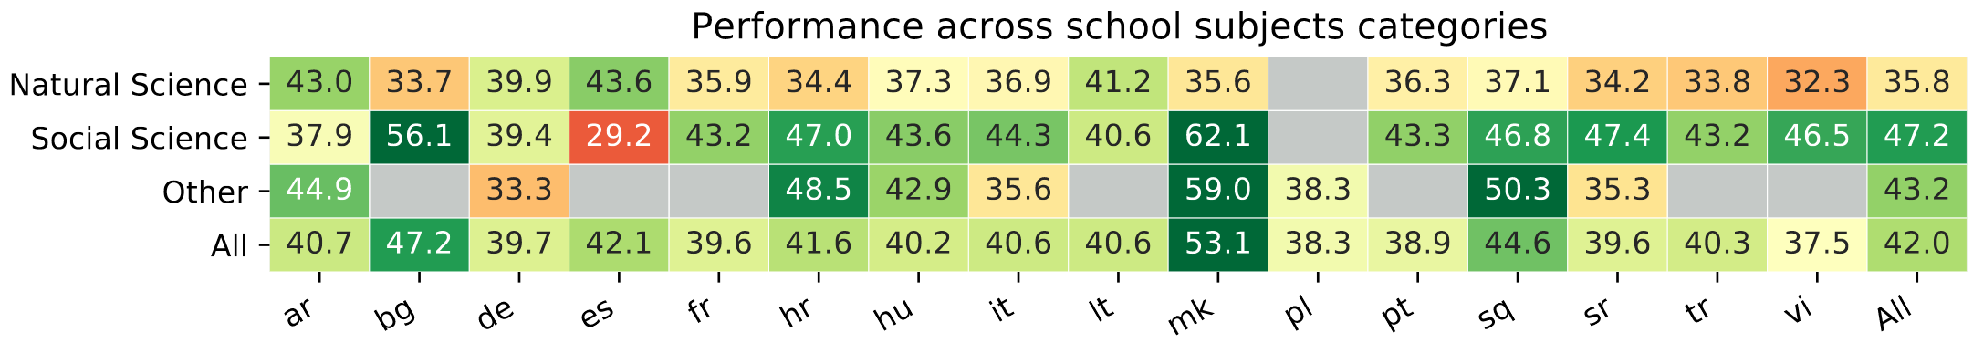
Per-subject Fine-grained Evaluation
Goal: Better understanding of the errors that the model makes.
Per group
Notes:
Fine-grained in QA is not new (Mihaylov and Frank, 2019; Xu et al., 2020)

Slide 31
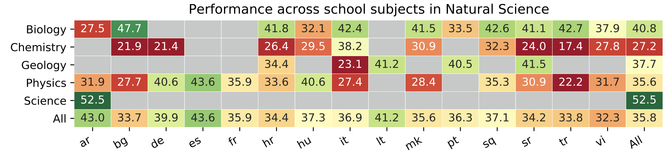
Per-subject Fine-grained Evaluation
Goal: Better understanding of the errors that the model makes.
Per group
Per Subject
Notes:
Fine-grained in QA is not new (Mihaylov and Frank, 2019; Xu et al., 2020)

Slide 32
Per-subject Fine-grained Evaluation
Goal: Better understanding of the errors that the model makes.
Per group
Per Subject
Social Science: highest accuracy, word matching nature
Natural Science: hardest, require complex skills
Other: subjects with varied difficulty
Notes:
Fine-grained in QA is not new (Mihaylov and Frank, 2019; Xu et al., 2020)

Slide 33
Summary and Future Work
Summary
Eχαμs - A new multilingual dataset from high-school examinations
24K questions in 16 languages from 8 families
Multilingual and cross-lingual testbeds
Per-subject fine-grained evaluation framework
The data, and code are available at http://github.com/mhardalov/exams-qa
Future Work
Extend the dataset to more languages/subjects
Improve evidence passage extraction
Add new knowledge sources

Slide 34
Download the data, run new models!
https://github.com/mhardalov/exams-qa
If you have more questions feel free to write at hardalov@fmi.uni-sofia.bg

Slide 35
Thank you!

Slide 36
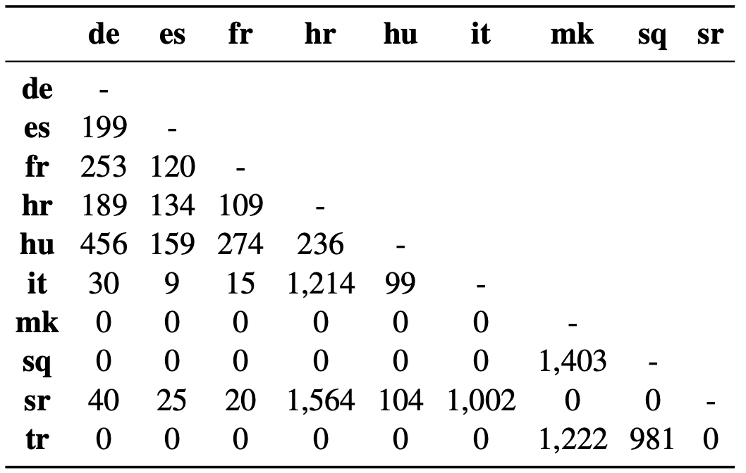
Parallel Questions
Some countries have exams in several languages
Croatia (Croatian, Serbian, Italian, Hungarian)
Hungary (Hungarian, German, French, Spanish, Croatian, Serbian, Italian)
North Macedonia (Macedonian, Albanian, Turkish)
Translated by experts
Not all exams are available in all languages
Notes:
Some countries allow students to take official examinations in several languages

Slide 37
QA Tasks and Datasets
Science QA
Multilignual QA
Regents (Clark et al., 2019)
TyDi (Clark et al., 2020)
ARC (Clark et al., 2018)
MKQA (Longpre et al., 2020)
SciQA (Welbl et al., 2017)
XQuAD (Artetxe et al., 2020)
OpenBookQA (Mihaylov et al., 2018)
MLQA (Lewis et al., 2020)
LifeCycleQA (Mitra et al., 2018)
KorQuAD (Lim et al.,2019)
RACE (Lai et al., 2017)
FQuAD (d’Hoffschmidt et al., 2020)
QuaRel (Tajford et al., 2018)
SberQuAD (Efimov et al., 2020)

Slide 38
Multilingual Evaluation
The model memorizes, however the questions are well designed.
Standard Baselines
With External Knowledge
6.9%
9%
No External Knowledge

Slide 39
Multilingual Evaluation
Fine-tuning on QA (in-domain) data from multiple languages has a large impact.
Standard Baselines
21-49%
13%
5-12%
0.5%
With External Knowledge
No External Knowledge
*All the baselines that require context, query an inverted index built on top of the language specific Wikipedias’ dumps.

